Slide 1
Township of Franklin Public Schools
Main Road School 1452 Main Road Newfield, NJ 08344
Mary F. Janvier School 1532 Pennsylvania Ave. Franklinville, NJ 08322
Caroline L. Reutter School 2150 Delsea Drive Franklinville, NJ 08322
Summer 2016 –
parking lot improvement status update
July 20, 2016

Slide 2
Main Road
School
parking lot improvement status update – main road school

Slide 3
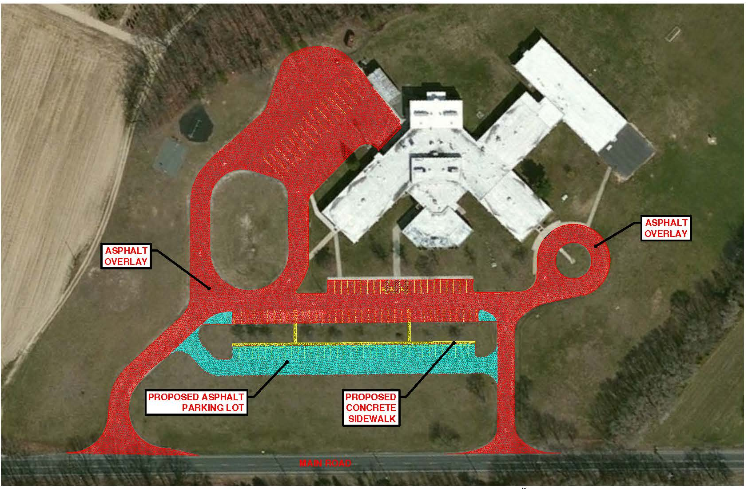
parking lot improvement status update – main road school

Slide 4
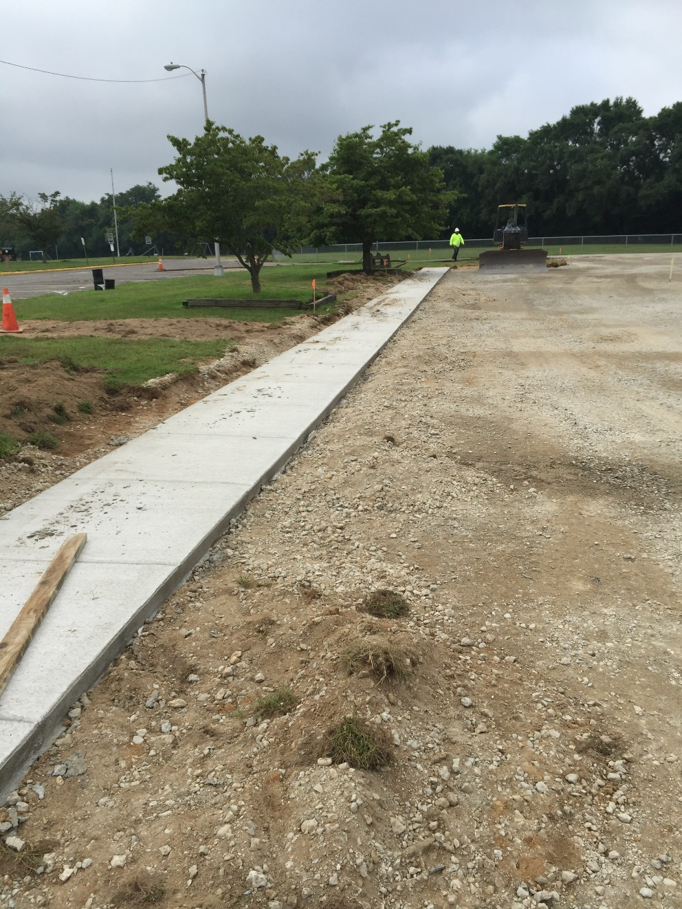
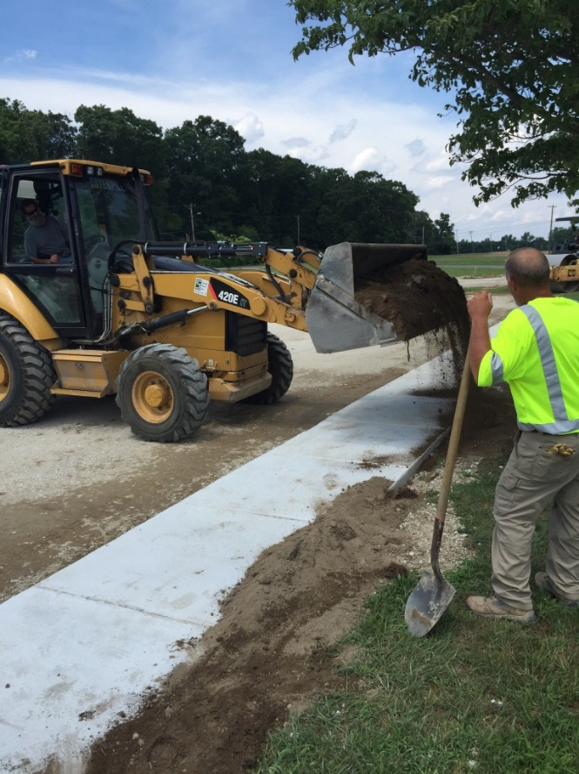
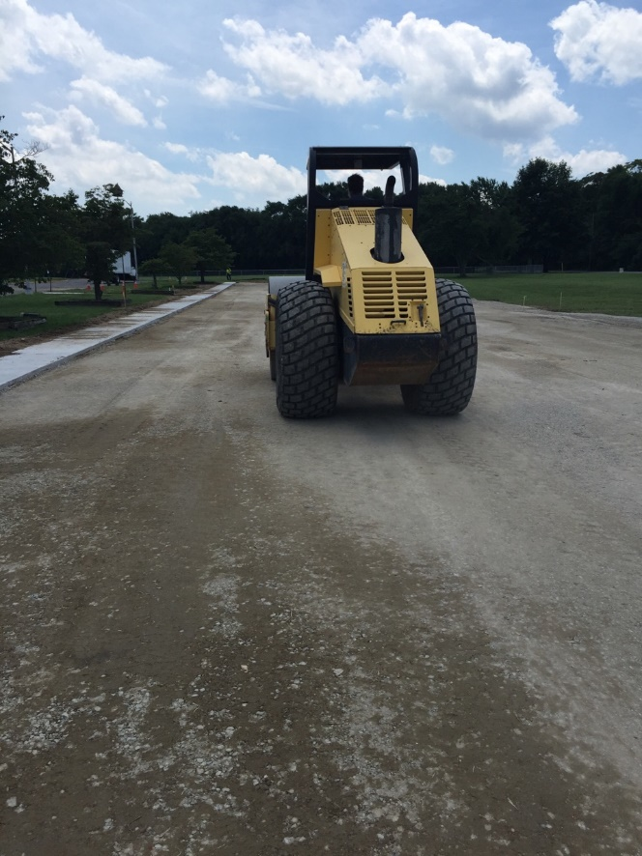
Completion of concrete sidewalk and DENSE GRADED AGGREGATE FOR new asphalt parking lot in front of main road school
parking lot improvement status update – main road school

Slide 5
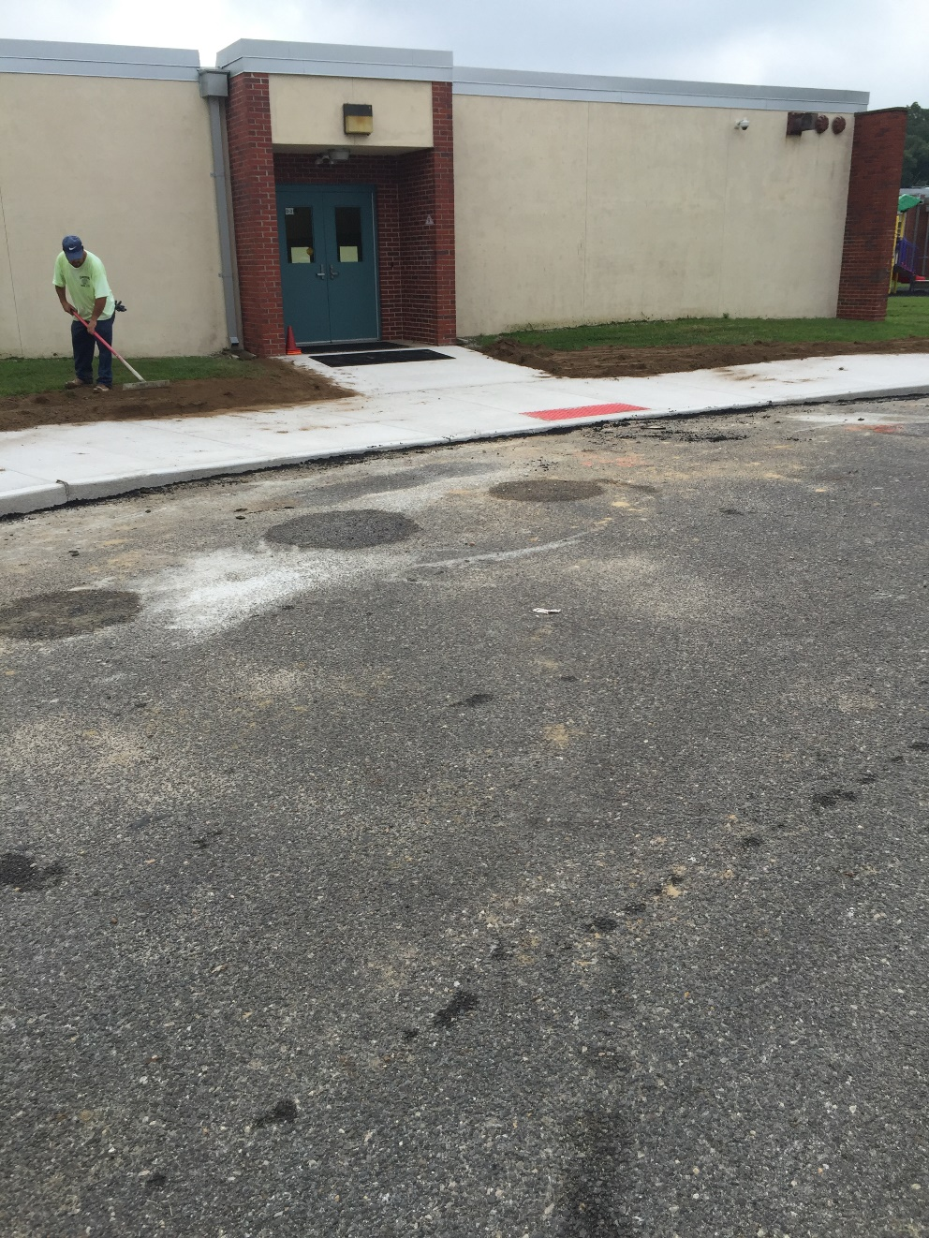
Completion of concrete sidewalk and handicap ramp
Along circular drop-off area
parking lot improvement status update – main road school

Slide 6
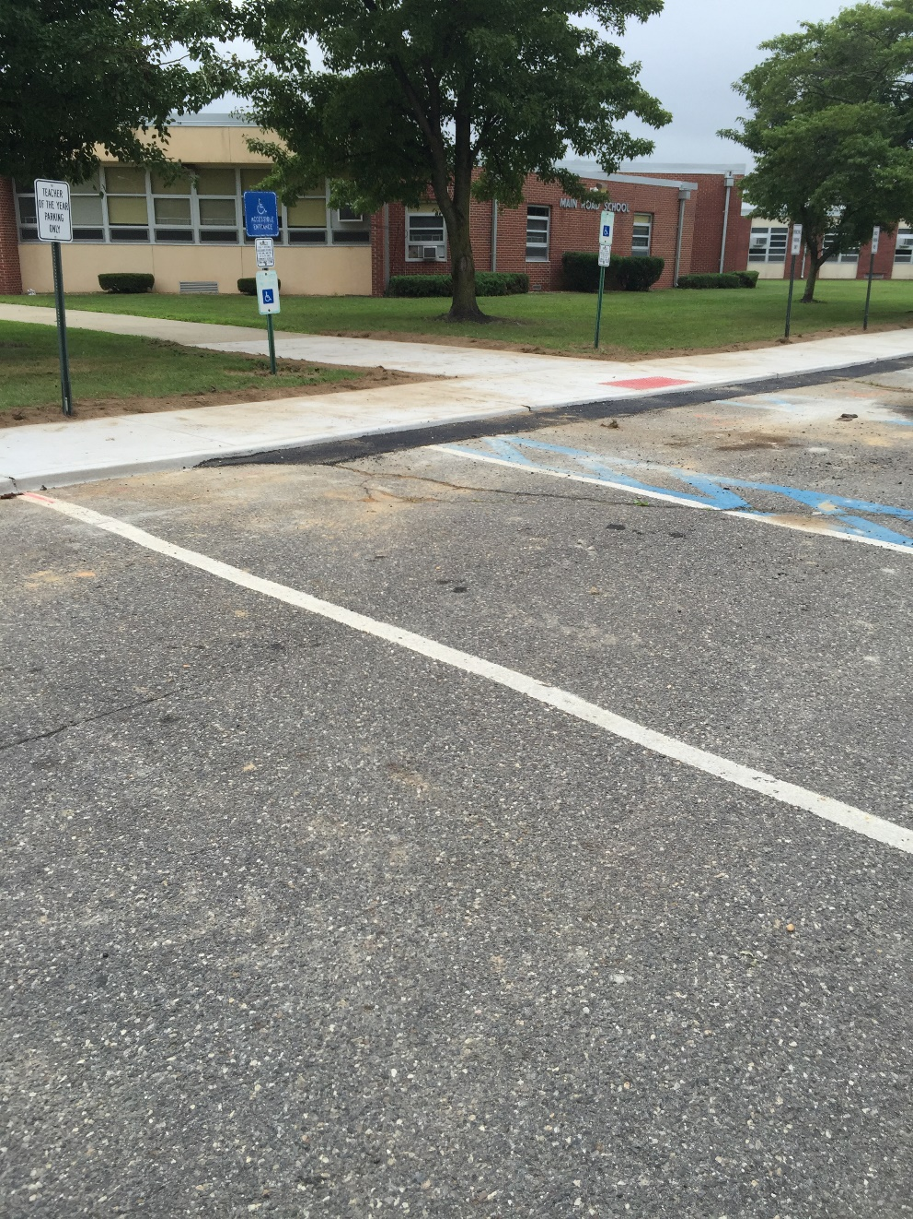
Completion of concrete sidewalk and handicap ramp in front of main road school
parking lot improvement status update – main road school

Slide 7
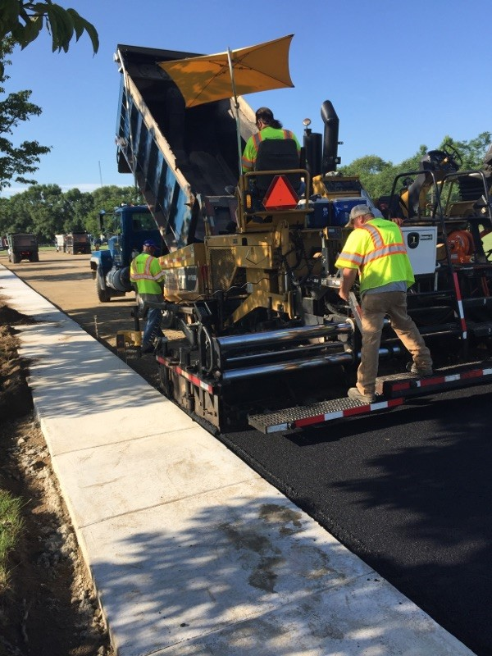
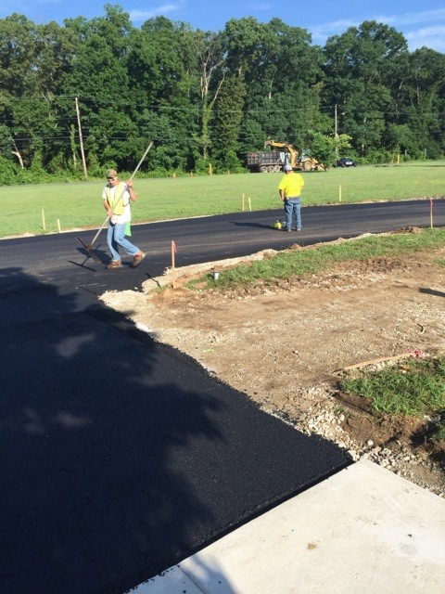
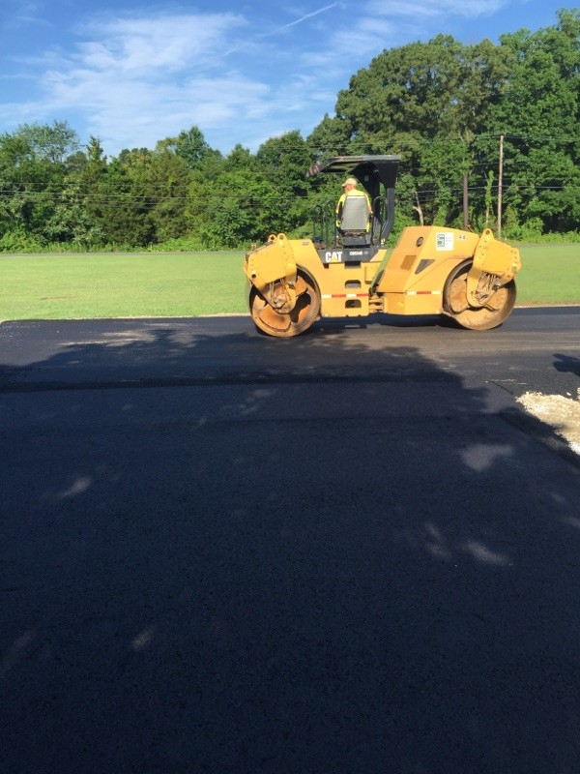
Asphalt overlay at main road school
parking lot improvement status update – main road school

Slide 8
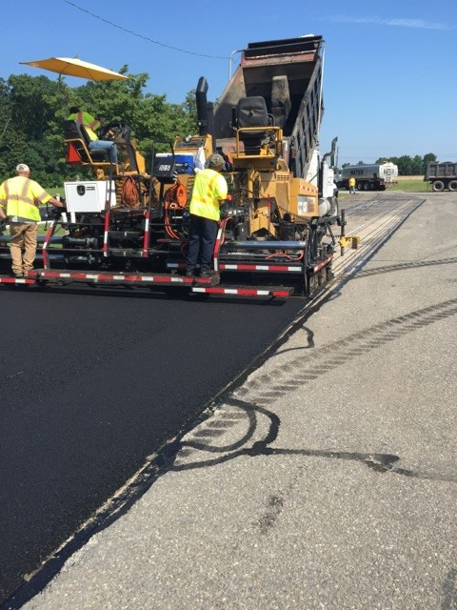
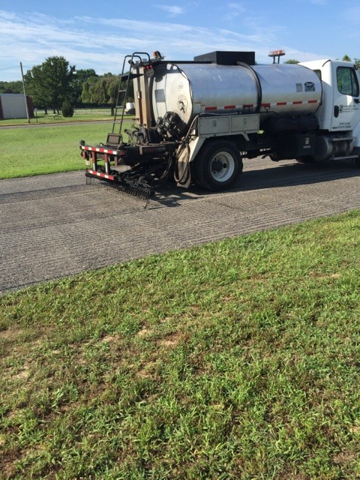
Asphalt overlay at main road school
parking lot improvement status update – main road school

Slide 9
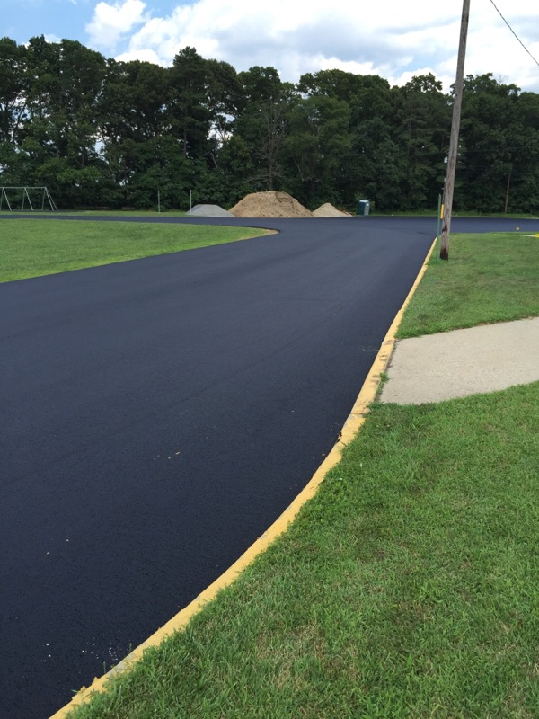
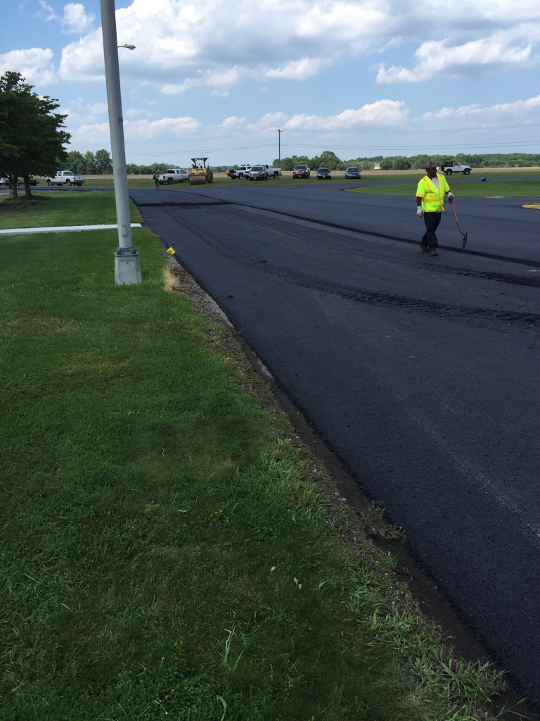
Asphalt overlay at main road school
parking lot improvement status update – main road school

Slide 10
Mary F. Janvier
School
parking lot improvement status update – mary f. janvier school

Slide 11
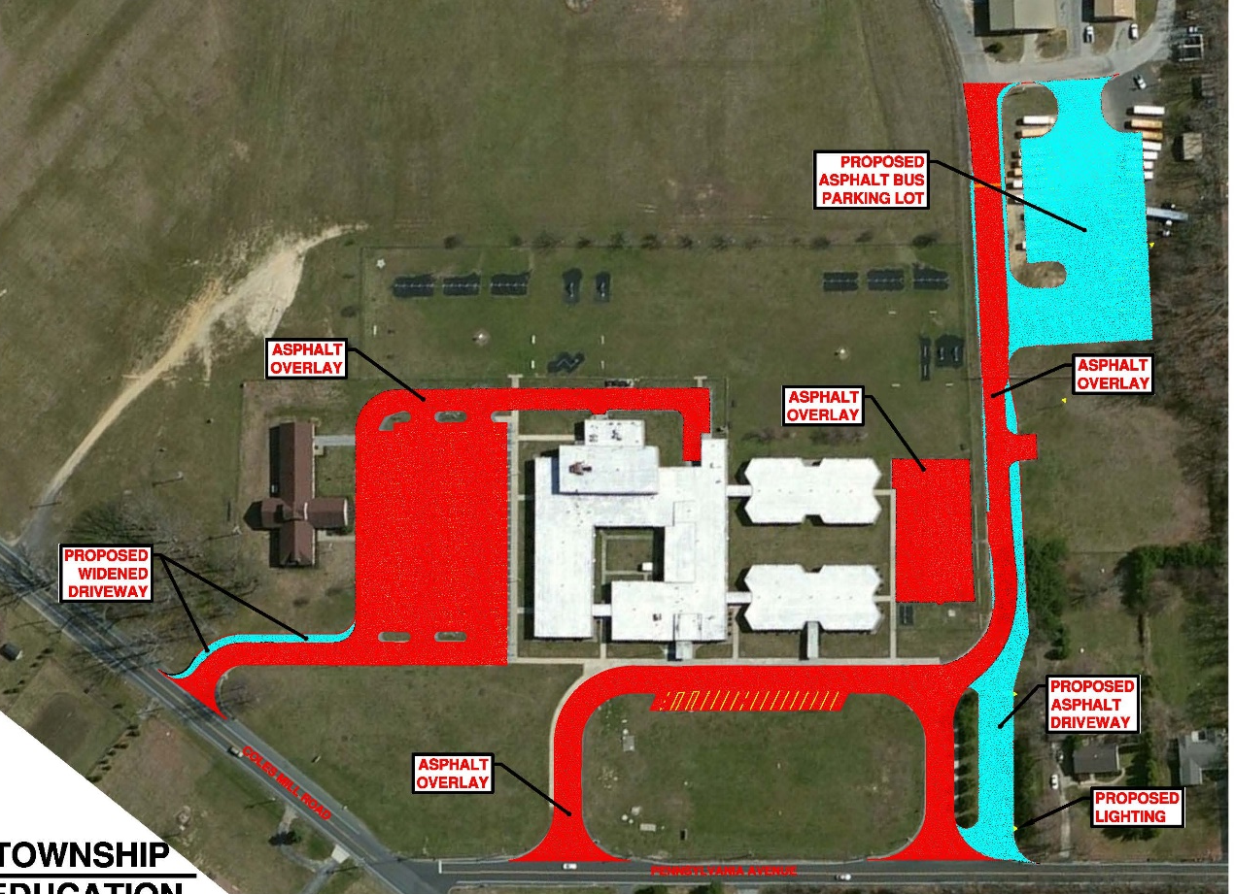
parking lot improvement status update – mary f. janvier school

Slide 12
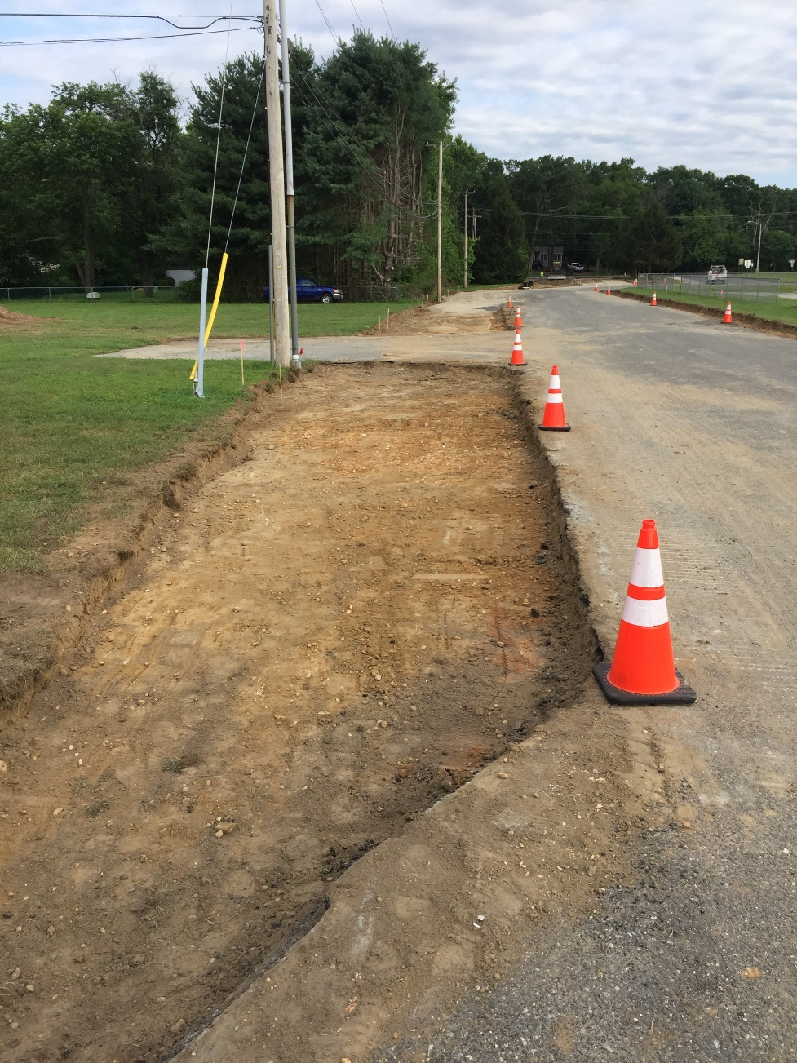
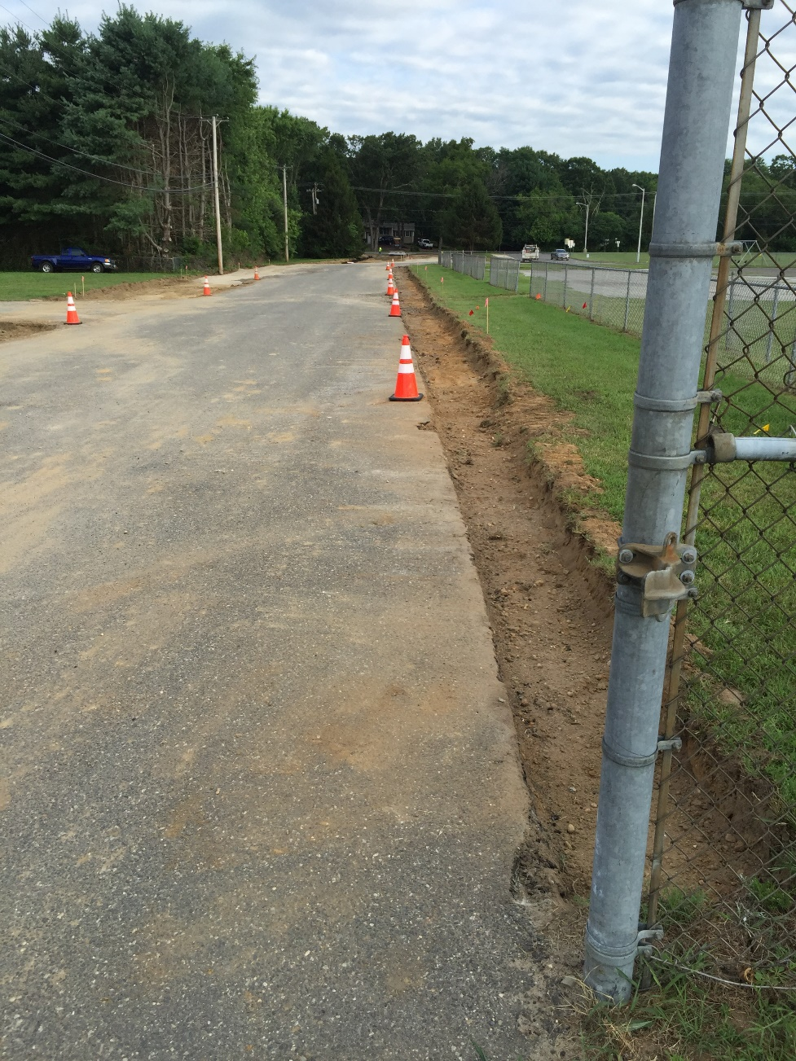
DRIVEWAY WIDENING at MARY F. JANVIER SCHOOL
parking lot improvement status update – mary f. janvier school

Slide 13
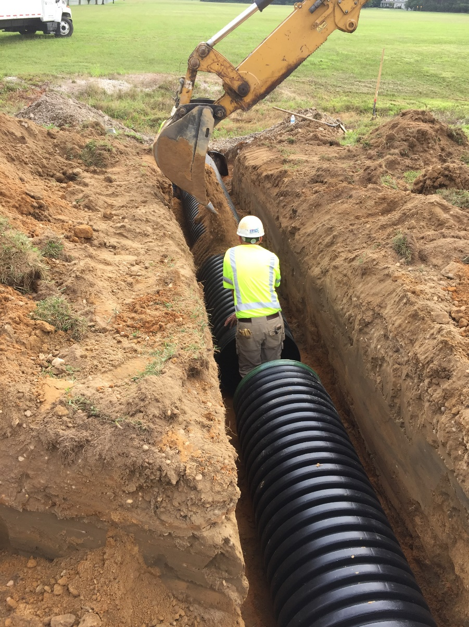
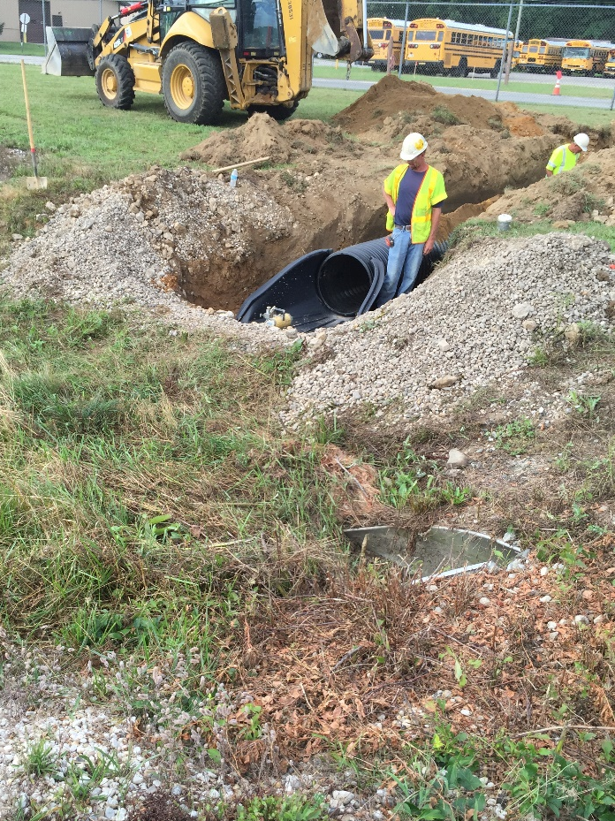
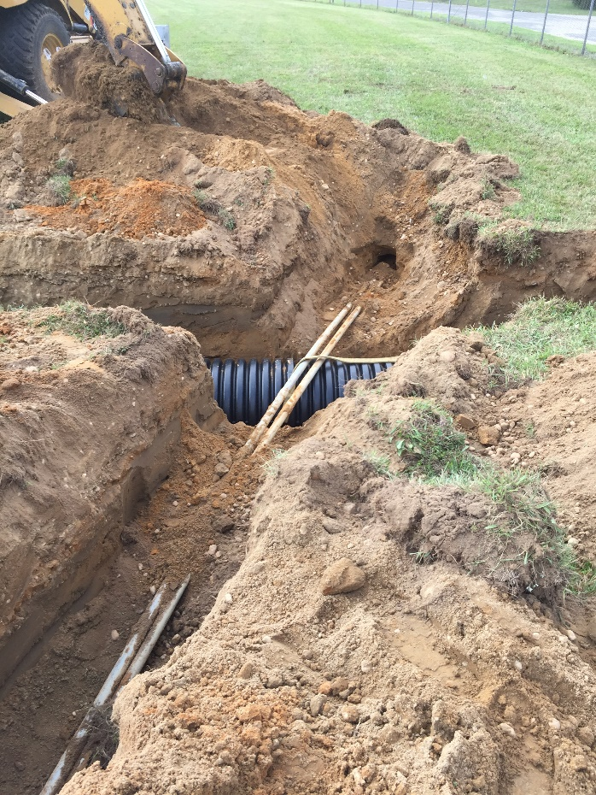
New stormwater pipe to drain stormwater from new asphalt bus parking lot
parking lot improvement status update – mary f. janvier school

Slide 14
Caroline L.
Reutter
School
parking lot improvement status update – caroline l. reutter school

Slide 15
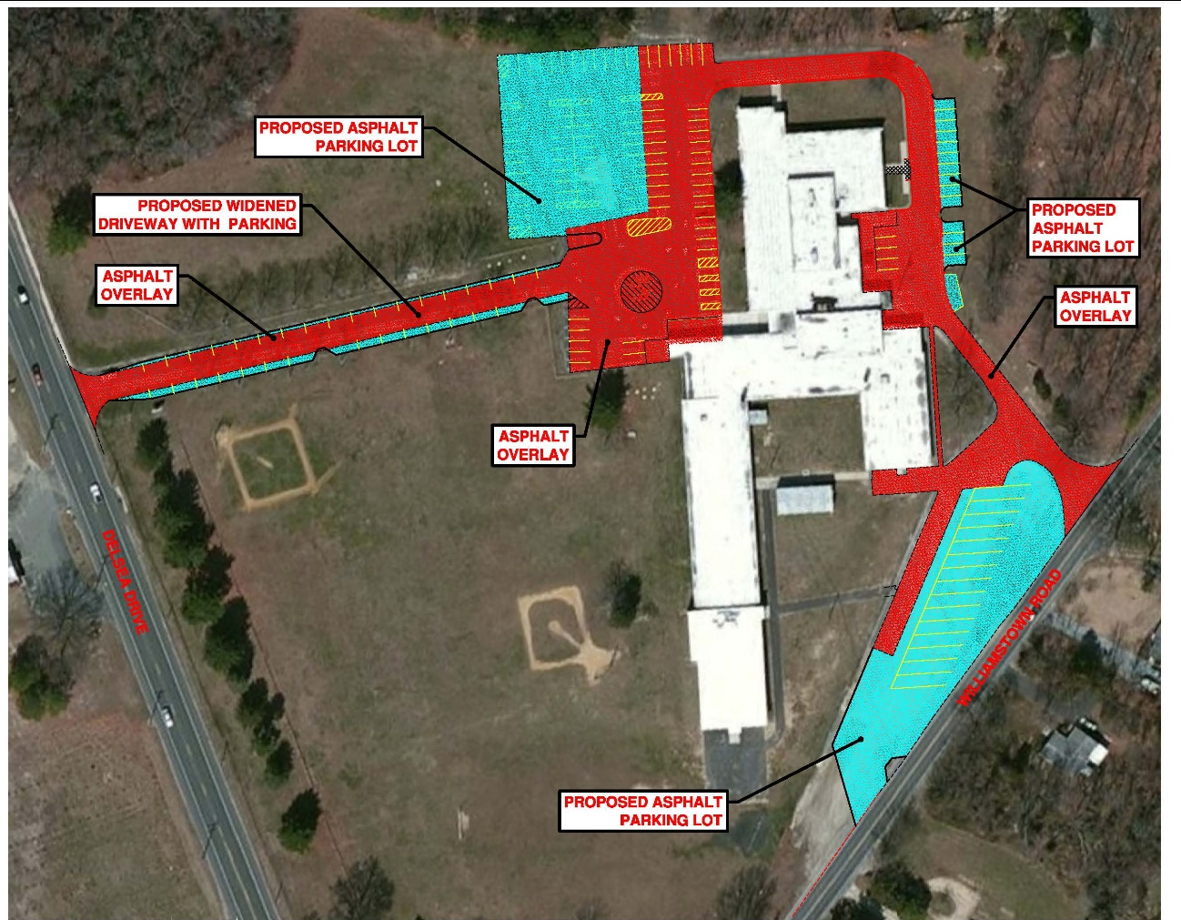
parking lot improvement status update – caroline l. reutter school

